Slide 1
Executive Summary
The assignment underscored working with SpaceX launch data to be gathered from an API,
specifically the Space X Rest API focused on if SpaceX will reuse the first stage to the price of
each launch through gathering information about space x. Overall, it is expected that the API will
give data about launches, including information about the rocket used, payload delivered,
launch specifications, landing specifications, and landing outcome.
To this end, the methods used to undertake the assignment include data collection, data
wrangling, exploratory data analysis, EDA with visualization lab, interactive visual analytics and
dashboard, and predictive analysis.
In general, the success rate since 2013 kept increasing till 2020. There were no rockets launched
for heavypayloadmass (greater than 1000) for VAFB-SLC. Success seems to be related to the
number of flights on LEO Orbit. However, there is no relationship between flight number and
success.
The record on the test template was 18. After selecting the best hyperparameters for the decision
tree classifier using the validation data, the accuracy achieved on the test data was 83.3%.
Furthermore, the assignment uncovered the names of unique launch sites in the space mission
include CCAFS SLC -40, KSL LC39, VAFB SLC-4E, CCAFS LC-40. The Total payload mass carried
by boosters launched by NASA(CRS) is 44,903 and the average payload mass by booster version
F9 v11 is 2928.4. The first successful landing outcome in ground was achieved on 05/11/2017. In
total, there were 55 successful and 10 failure mission outcomes respectively.

Slide 2
Introduction
The applied data science capstone project has attempted to deal with equipping the
data science student to apply the skills as a data scientist for a private space launch company.
As a starting point of almost all data science projects, the project required collecting
data as much and relevant as possible. The data collection process has covered
various sources. The data scientist was also expected to improve the quality of data collected by performing data wrangling.
The major question the project attempted to respond was the price of each launch
accessing through gathering information about space x and creating dashboards for
the team as well as training a machine learning model and using public information
aiming in view of determining if SpaceX will reuse the first stage.
The project endeavor further explored the processed data by way of practicing SQL
skills that query the data and gather insights. Moreover, the project applied some basic statistical analysis and data visualization.
Before discussing findings and reaching a conclusion, the project attempted to drill
down to groups defined by categorical variables or factors in the data.
Overall, the project outcome was guided to build, evaluate and refine predictive models for discovering more exciting insights.

Slide 3
EDA with SQL
SQL Notebook for Peers Assignment

Slide 4
Collecting SpaceX Data

Slide 5
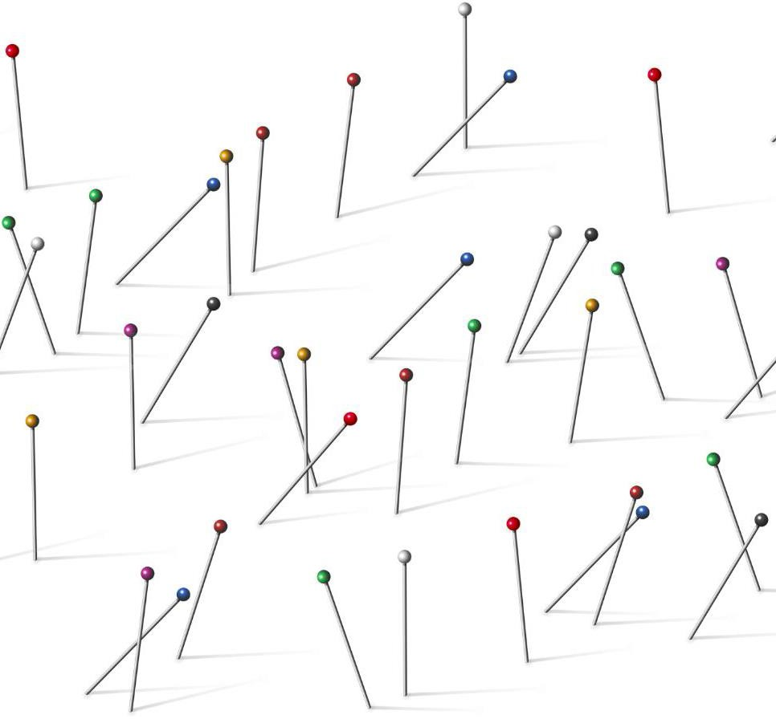
Essential EDA Visualizations

Slide 6
Scrapping Process

Slide 7
Web Scraping for Data

Slide 8
Data Wrangling Methodology

Slide 9

Revealing Data Patterns
EDA visualizations uncover hidden patterns and trends in datasets, enabling a deeper understanding of the data. Spotting Anomalies and Outliers
Visual tools help quickly identify anomalies and outliers that may impact
analysis or require further investigation.
Understanding Relationships
EDA graphs reveal relationships between variables, supporting informed decision making and hypothesis generation.

Slide 10
EDA with visualization results slides
SpaceX Falcon 9 First Stage Landing prediction Assignment Exploring and Preparing Data

Slide 11
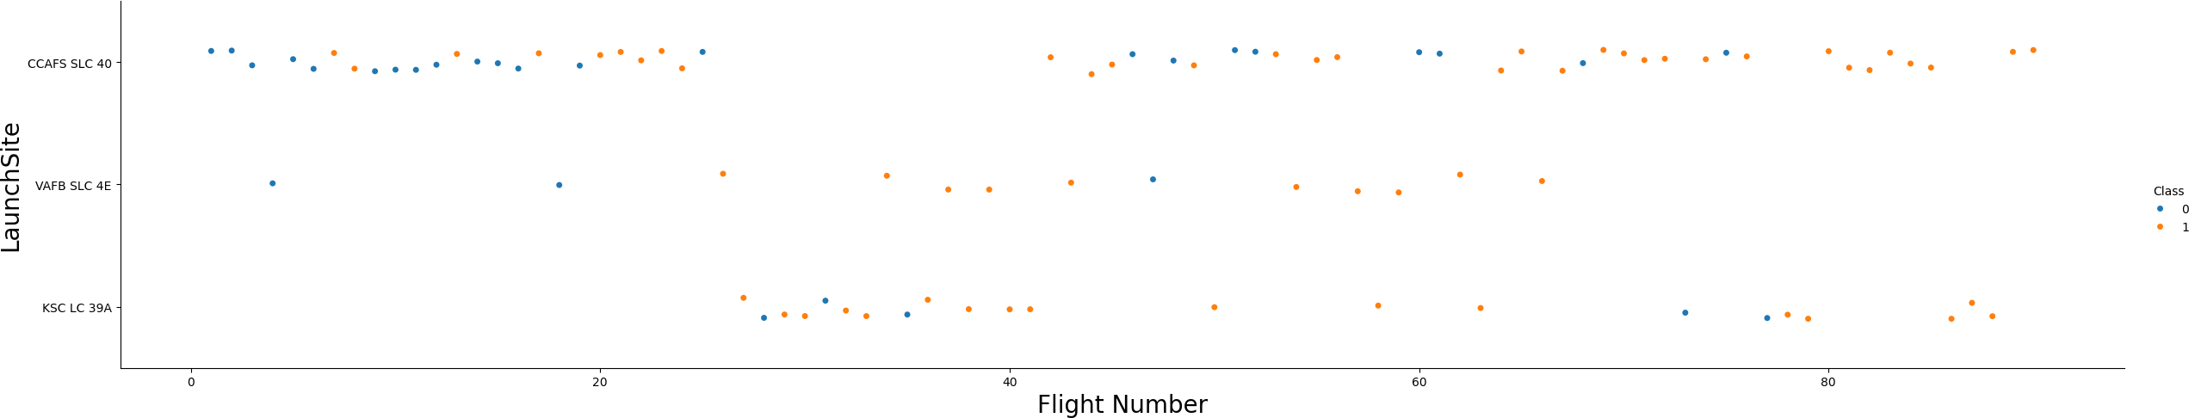
TASK 1: Visualize the relationship between Flight Number and Launch Site¶

Slide 12
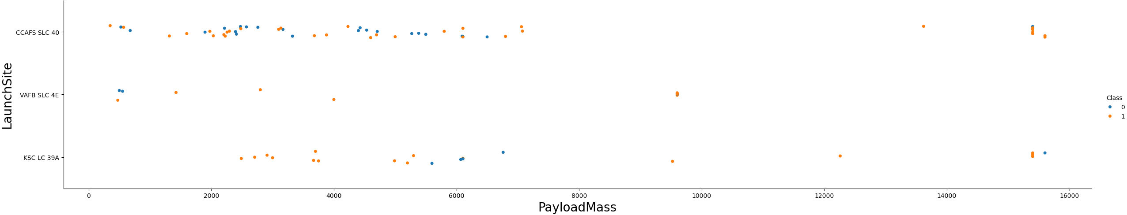
TASK 2: Visualize the relationship between Payload Mass and Launch Site

Slide 13
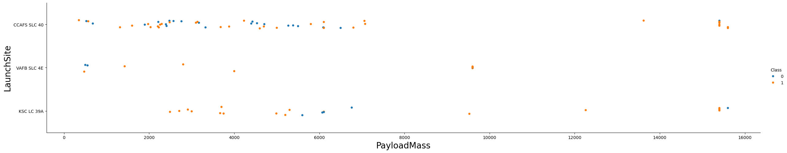
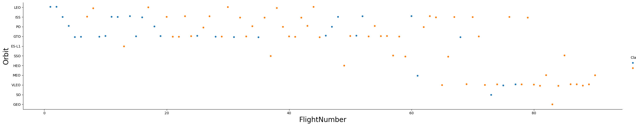
TASK 4: Visualize the relationship between FlightNumber and Orbit type

Slide 14
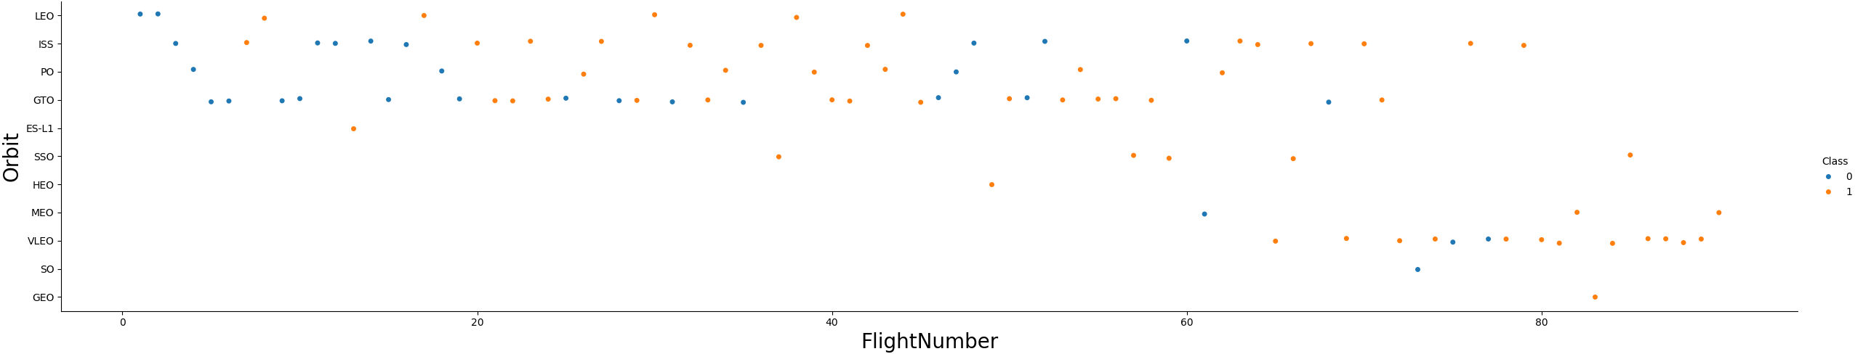
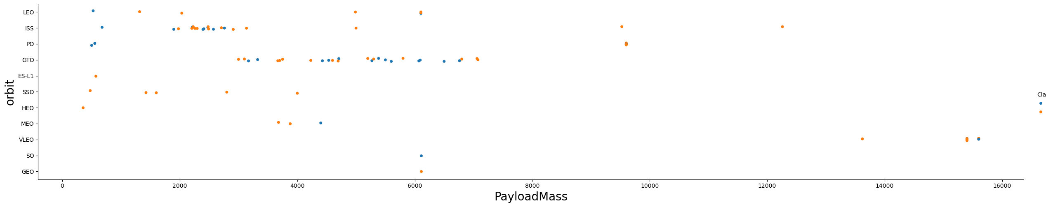
TASK 5: Visualize the relationship between Payload Mass and Orbit type

Slide 15
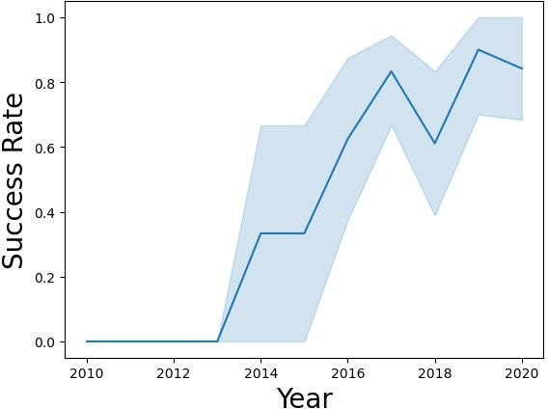
TASK 6: Visualize the launch success yearly trend¶

Slide 16
TASK 7: Create dummy variables to categorical columns
Original DataFrame:
Orbits LaunchSite LandingPad Serial
0 | LEO CCAFS SLC 40 | NaN B0003
1 | LEO CCAFS SLC 40 | NaN B0005
2 | ISS CCAFS SLC 40 | NaN B0007
3 | PO VAFB SLC 4E | NaN B1003
4 | GTO CCAFS SLC 40 | NaN B1004

Slide 17
TASK 8: Cast all numeric columns to float64
# Cast the entire DataFrame to flaot64df = pd.read_csvdf_encoded = pd.get_dummies(df, columns := ['FlightNumber', 'PayloadMass', 'Flights', 'Block', 'ReusedCount'], df
= int)df = df.astype(np.float64)print(df.head())

Slide 18
# Get the head of the dataframe data.head()
static_fire_date_utc
static_fire_date_unix
tbd
net
window
rocket
success
details
crew
ships
capsules
payloads
launchpad
auto_update
failures
flight_number
name
date_utc
date_unix
date_local
date_precision
upcoming
cores
id
fairings.reused
fairings.recovery_attempt
fairings.recovered
fairings.ships
links.patch.small
links.patch.large
links.reddit.campaign
links.reddit.launch
links.reddit.media
links.reddit.recovery
links.flickr.small
links.flickr.original
links.presskit
links.webcast
links.youtube_id
links.article
links.wikipedia
fairings
0
2006-03-17T00:00:00.000Z
1.142554e+09
False
False
0.0
5e9d0d95eda69955f709d1eb
False Engine failure at 33 seconds and loss of vehicle
[]
[]
[]
[5eb0e4b5b6c3bb0006eeb1e1]
5e9e4502f5090995de566f86
True [{'time': 33, 'altitude': None, 'reason': 'merlin
1
FalconSat
2006-03-24T22:30:00.000Z
1143239400
2006-03-25T10:30:00+12:00
hour
[{'core': '5e9e289df35918033d3b2623', 'flight': 1,
False 'gridfins': False, 'legs': False, 'reused': False, 'landing_attempt': False, 'landing_success': None,
'landing_type': None, 'landpad': None}]
5eb87cd9ffd86e000604b32a
False
False
False
[] https://images2.imgbox.com/3c/0e/T8iJcSN3_o. png https://images2.imgbox.com/40/e3/Gyp SkayF_o.pn
None
None
None
None
[]
[]
None https://www.youtube.com/watch?v=0a _00nJ_ Y88
0a_00nJ_Y88 https://www.space.com/2196-spacex-ina ugural- https://en.wikipedia.org/wiki/DemoSat
NaN
engine failure'}]
g
falcon-1-rocket-lost-launch.html
1
None
NaN
False
False
0.0
5e9d0d95eda69955f709d1eb
Successful first stage burn and transition to second
False stage, maximum altitude 289 km, Premature engine shutdown at T+7 min 30 s, Failed to reach orbit,
Failed to recover first stage
[]
[]
[]
[5eb0e4b6b6c3bb0006eeb1e2]
5e9e4502f5090995de566f86
True [{'time': 301, 'altitude': 289, 'reason': 'harmonic
2
DemoSat
2007-03-21T01:10:00.000Z
1174439400
2007-03-21T13:10:00+12:00
hour
[{'core': '5e9e289ef35918416a3b2624', 'flight': 1,
False 'gridfins': False, 'legs': False, 'reused': False, 'landing_attempt': False, 'landing_success': None,
'landing_type': None, 'landpad': None}]
5eb87cdaffd86e000604b32b
False
False
False
[] https://images2.imgbox.com/4f/e3/I0lku J2e_o.p ng https://images2.imgbox.com/be/e7/iNqs qVYM_o.pn
g
None
None
None
None
[]
[]
None https://www.youtube.com/watch?v=Lk 4zQ2wP-Nc
Lk4zQ2wP-Nc https://www.space.com/3590-spacex-fal con-1- https://en.wikipedia.org/wiki/DemoSat
NaN
oscillation leading to premature engine shutdown'}]
rocket-fails-reach-orbit.html
2
None
NaN
False
False
0.0
5e9d0d95eda69955f709d1eb
False Residual stage 1 thrust led to collision between
[]
[]
[]
[5eb0e4b6b6c3bb0006eeb1e3, 5eb0e4b6b6c3bb0006eeb1e4]
5e9e4502f5090995de566f86
[{'time': 140, 'altitude': 35, 'reason': 'residual stage- True 1 thrust led to collision between stage 1 and stage
2'}]
3
Trailblazer
2008-08-03T03:34:00.000Z
1217734440
2008-08-03T15:34:00+12:00
hour
[{'core': '5e9e289ef3591814873b2625', 'flight': 1,
False 'gridfins': False, 'legs': False, 'reused': False, 'landing_attempt': False, 'landing_success': None,
'landing_type': None, 'landpad': None}]
5eb87cdbffd86e000604b32c
False
False
False
[] https://images2.imgbox.com/3d/86/cnu0 pan8_o .png https://images2.imgbox.com/4b/bd/d8U xLh4q_o .png
None
None
None
None
[]
[]
None https://www.youtube.com/watch?v=v0 w9p3U8860
v0w9p3U8860 http://www.spacex.com/news/2013/02/ 11/falcon-1- https://en.wikipedia.org/wiki/Trailblaze r_(sate llite)
NaN
stage 1 and stage 2
flight-3-mission-summary
3
2008-09-20T00:00:00.000Z
1.221869e+09
False
False
0.0
5e9d0d95eda69955f709d1eb
Ratsat was carried to orbit on the first successful
True orbital launch of any privately funded and developed, liquid-propelled carrier rocket,
the SpaceX Falcon 1
[]
[]
[]
[5eb0e4b7b6c3bb0006eeb1e5]
5e9e4502f5090995de566f86
True
[]
4
RatSat
2008-09-28T23:15:00.000Z
1222643700
2008-09-28T11:15:00+12:00
hour
[{'core': '5e9e289ef3591855dc3b2626', 'flight': 1,
False 'gridfins': False, 'legs': False, 'reused': False, 'landing_attempt': False, 'landing_success': None,
'landing_type': None, 'landpad': None}]
5eb87cdbffd86e000604b32d
False
False
False
[] https://images2.imgbox.com/e9/c9/T8Cfi SYb_o. png https://images2.imgbox.com/e0/a7/FNjv KlXW_o.png
None
None
None
None
[]
[]
None https://www.youtube.com/watch?v=dLQ2tZEH 6G0
dLQ2tZEH6G0 https://en.wikipedia.org/wiki/Ratsat https://en.wikipedia.org/wiki/Ratsat
NaN
4
None
NaN
False
False
0.0
5e9d0d95eda69955f709d1eb
True
None
[]
[]
[]
[5eb0e4b7b6c3bb0006eeb1e6]
5e9e4502f5090995de566f86
True
[]
5
RazakSat
2009-07-13T03:35:00.000Z
1247456100
2009-07-13T15:35:00+12:00
hour
[{'core': '5e9e289ef359184f103b2627', 'flight': 1,
False 'gridfins': False, 'legs': False, 'reused': False, 'landing_attempt': False, 'landing_success': None,
'landing_type': None, 'landpad': None}]
5eb87cdcffd86e000604b32e
False
False
False
[] https://images2.imgbox.com/a7/ba/NBZ Sw3Ho _o.pn https://images2.imgbox.com/8d/fc/0qdZ MWWx_o.p
None
None
None
None
[]
[] http://www.spacex.com/press/2012/12/ 19/spacexs- https://www.youtube.com/watch?v=yT aIDooc8Og
yTaIDooc8Og http://www.spacex.com/news/2013/02/ 12/falcon-1- https://en.wikipedia.org/wiki/RazakSAT
NaN
g ng
falcon-1-successfully-delivers-razaksat-sa tellite-orbit
flight-5

Slide 19
Using API again to get information about the launches using the ids given for each launch
We will now use the API again to get information about the launches using the IDs given for each launch. Specifically we will be using columns rocket, payloads, launchpad, and cores.
# Lets take a subset of our dataframe keeping only the features we want and a flight number and date_utc.
data = data[['rocket','payloads','launchpad','cores', 'flight_number','date_utc']]
# We will remove rows with multiple cores because those are falcon rockets with extra rocketboosters and rows that have multiple payloads in asingle rocket.
data = data[data['cores'].map(len)==1]
data = data[data['payloads'].map(len)==1]
# Since payloads and cores are lists of size 1 we will also extract the single value in the list and replace the feature.
data['cores'] = data['cores'].map(lambda x : x [0])
data['payloads']= data ['payloads'].map(lambda x : x [0])
# We also want to convert the date_utc to datetime datatype and then extracting the date leaving the time
data['date'] = pd.to_datetime(data['date_utc']).dt.date
# Using the date we will restrict the dates of the launches
data = data[data['date'] <= datetime.date(2020, 11, 13)]
rom the rocket we would like to learn the booster name
From the payload we would like to learn the mass of the payload and the orbit that it is going to
From the launchpad we would like to know the name of the launch site being used, the longitude, and the latitude.

Slide 20
Lists to store data from these requests and be used to create a new data frame
BoosterVersion = []
PayloadMass = []
Orbit = []
launchSite = []
Outcome = []
Flights = []
GridFins = []
Reused = []
Legs = []
LandingPad = []
Block = []
ReusedCount = []
Serial = []
Longitude = []
Latitude = []

Slide 21
Show the summary of the dataframe
rocket
payloads
launchpad
cores
flight_number
date_utc
date
0
5e9d0d95eda69955f709d1eb
5eb0e4b5b6c3bb0006eeb1e1
{'core': '5e9e289df35918033d3b2623', 'flight': 1, 'gridfins': False, 'legs': False, 'reused': 5e9e4502f5090995de566f86 False, 'landing_attempt': False, 'landing_success': None, 'landing_type': None,
'landpad': None}
1
2006-03-24T22:30:00.000Z
2006-03-24
1
5e9d0d95eda69955f709d1eb
5eb0e4b6b6c3bb0006eeb1e2
5e9e4502f5090995de566f86
{'core': '5e9e289ef35918416a3b2624', 'flight': 1, 'gridfins': False, 'legs': False, 'reused': False, 'landing_attempt': False, 'landing_success': None, 'landing_type': None,
'landpad': None}
2
2007-03-21T01:10:00.000Z
2007-03-21
3
5e9d0d95eda69955f709d1eb
5eb0e4b7b6c3bb0006eeb1e5
{'core': '5e9e289ef3591855dc3b2626', 'flight': 1, 'gridfins': False, 'legs': False, 'reused': 5e9e4502f5090995de566f86 False, 'landing_attempt': False, 'landing_success': None, 'landing_type': None,
'landpad': None}
4
2008-09-28T23:15:00.000Z
2008-09-28
4
5e9d0d95eda69955f709d1eb
5eb0e4b7b6c3bb0006eeb1e6
{'core': '5e9e289ef359184f103b2627', 'flight': 1, 'gridfins': False, 'legs': False, 'reused': 5e9e4502f5090995de566f86 False, 'landing_attempt': False, 'landing_success': None, 'landing_type': None,
'landpad': None}
5
2009-07-13T03:35:00.000Z
2009-07-13
5
5e9d0d95eda69973a809d1ec
5eb0e4b7b6c3bb0006eeb1e7
5e9e4501f509094ba4566f84
{'core': '5e9e289ef359185f2b3b2628', 'flight': 1, 'gridfins': False, 'legs': False, 'reused': False, 'landing_attempt': False, 'landing_success': None, 'landing_type': None,
'landpad': None}
6
2010-06-04T18:45:00.000Z
2010-06-04

Slide 22
Task 2: Filter the dataframe to only include Falcon 9 launches¶
getBoosterVersion(data)
['Falcon1', 'Falcon1', 'Falcon 1', 'Falcon 1', 'Falcon 9']
data_fal
# Reset the Index so it strats at 0,1,2....
filtered_df = filtered_df.reset_index(drop= True)con9 = data.loc[data['Flights'] == 'falcon9’]
print("Number of Nan values for the column Falcon 1 :", df['Falcon 1'].isnull().sum())
print ("Number of Nan Values for the column Falcon 9 :", df['Falcom 9'"].isnull().sum())

Slide 23
Task 3: Dealing with Missing Values¶
mean=df['Falcon 9'].mean()
df['Falcon 9'].replace(np.nan),mean inplace=True
print("number of Nan Values for the column Falcon 1 :", df['Falcon 1'].isnull().sum())
print("number of Nan Values for the column Falcon 9 :", df['Falcon 9'].isnull().sum())

Slide 24
Predictive Analysis Methodology Slides
Complete the Machine Learning Prediction lab

Slide 25
Standardize the data
pipeline = Pipeline([ ('scaler', StandardScaler()), # Step 1:
Standardize features ('pca', PCA(n_components=2),),
#
Step 2: Reduce dimensions to 2 using PCA ('knn', KNeighborsClassifier(n_neighbors=5,)) # Step 3: K-Nearest Neighbors classifier])

Slide 26
Split the data X and Y into training and test data. Set the parameter test_size to 0.2 and random_state to 2
X_train, X_test, y_train, y_test = train_test_split(..., ...,
test_size=0.2,stratify=, random_state=2)numeric_features =
X_train.select_dtypes(include=['...']).column.tolist()categorical_feature
s = X_train.select_dtypes(include=['...','category']).column.tolist()# Scale
the numeric featuresnumeric_transformer = Pipeline(steps=[('scaler',
StandardScaler())])# One-hot encode the
categorialscategorical_transformer = Pipeline(steps=[('onehot',
OneHotEncoder(handle_unknown='ignore'))])preprocessor =
CloumnTransfer( transformers =[
('num', numeric_transformer,...),
('cat', categorical_transformer,...) ]) pipeline = Pipeline(steps=[
('prerocessor', ...), ('...',RandomforestClassifier(rando_state=42))])
param_grid = { 'classifier_n_estimators': [50, 100],
'classifier_max_depth': [None, 10,20], 'classifier_min_samples_split':
[2, 5]}

Slide 27
Create a logistic Regression Object then Create GridSearchCV object
parameters = {'C':[0.01,0.01,1],
•
•
'penalty':['12'],
'solver':['lbfgs’]}
parameters = {"C":[0.01,0.1,1], 'penalty':['12'], 'solver':['lbfgs']} # l1 lasso l2 ridge
lr = LogisticRegression()logreg_cv = GridSearchCV(lr, param_grid=parameters,scoring='accuracy’
)logreg_cv.fit(X_train, y_train)
logreg_cv.best_params

Slide 28
Display the best parameters on the validation data and the accuracy on the validation data
best_model.fit(x_train,y_train)
test_score = best_model.score(...,...)
print(f"{testscore:test_score:.3f}")
test_score=best_model.score(x_test,ytest)
print(f"{testcore:test_score:.3f}")

Slide 29
Calculate the Accuracy on the test data using the method score
# pipeline.fit(x_train,y_train_test)
# measure the pipiline accuracy on the test datatest_score = 'pipeline'.score(x_test, y_test)
print(f"{test_score:3f}")

Slide 30
Lets look at the confusion matrix:
yhat = logreg_cv.predict(X_test)
plot_confusion_matrix(Y_test,yhat)

Slide 31
Create a support vector machine object & Fit the object to find the best parameters from the dictionary
parameters = {'criterion': ['gini', 'entropy'],
•
•
•
•
•
'splitter': ['best', 'random'], 'max_depth': [2*n for n in range(1,10)], 'max_features': ['auto', 'sqrt'], 'min_samples_leaf': [1, 2, 4],
'min_samples_split': [2, 5, 10]}
tree = 'DecisionTreeClassifier'> [()

Slide 32
Calculate the Accuracy on the test data using the method score
y_pred = best_model.predict(X_test)
# Generate the confusion matrix for KNN
Conf_matrix = confusion_matrix(y_test,y_pred)
# Create a single plot for the confusion matrix
plt.figure()
sns.heatmap(conf_matrix, annote=True ,cmap='Blues', fmt='d',
xticklabels=labes, yticklabels= labels)
# set the title and labels plt.title('KNN Classification Testing Confusion Matrix’)
plt.xlabel('Predicted’)
plt.ylabel('Actual’)
# Show the plot
plt.tight_layout()
plt.show()

Slide 33
Plot the confusion Matrix
yhat = 'knn_cv'.predict(X_test)
plot_confusion_matrix(Y_test,yhat)

Slide 34
Find methods that perform best
# Print test scoretest_score = model.best_estimator_.score((x_test),(y_test))print(f"n\Test set accuracy:{test:.2%}")

Slide 35
def date_time(table_cells):
"""
This function returns the data and time from the HTML table cell Input: the element of a table data cell extracts extra row
"""
return [data_time.strip() for data_time in list(table_cells.strings)][0:2]
def booster_version(table_cells):
"""
This function returns the booster version from the HTML table cell Input: the element of a table data cell extracts extra row
"""
out=''.join([booster_version for i,booster_version in enumerate( table_cells.strings) if i%2==0][0:-1])
return out
def landing_status(table_cells):
"""
This function returns the landing status from the HTML table cell Input: the element of a table data cell extracts extra row
"""
out=[i for i in table_cells.strings][0] return out
def get_mass(table_cells):

Slide 36
mass=unicodedata.normalize("NFKD", table_cells.text).strip()
if mass:
mass.find("kg") new_mass=mass[0:mass.find("kg")+2]
else:
new_mass=0 return new_mass
def extract_column_from_header(row):
"""
This function returns the landing status from the HTML table cell Input: the element of a table data cell extracts extra row
"""
if (row.br): row.br.extract()
if row.a:
row.a.extract() if row.sup:
row.sup.extract()
colunm_name = ' '.join(row.contents) # Filter the digit and empty names
if not(column_name.strip().isdigit()): colunm_name = colunm_name.strip()

Slide 37
return colunm_name

Slide 38
EDA SQL
SQL Notebook for Peer Assignment

Slide 39
ask 1
Display the names of the unique launch sites in the space mission¶
CCAFS SLC-40: KSL LC39: VAFB SLC-4E:CCAFS LC-40

Slide 40
Task 2
Display 5 records where launch sites begin with the string 'CCA'¶
LEO (ISS), NASA(COTS), NASA(CRS), Turkeminstan National Space Agency, AsiaSat

Slide 41
Task 3
Display the total payload mass carried by boosters launched by NASA (CRS)
44,903

Slide 42
Task 4¶
Display average payload mass carried by booster version F9 v1.1
2928.4

Slide 43
Task 5
List the date when the first succesful landing outcome in ground pad was acheived.¶
05/11/2017

Slide 44
Task 6
List the names of the boosters which have success in drone ship and have payload mass greater than 4000 but less than 6000¶
F9 FTB1022, F9 FTB1026,F9 FTB1021.2, F9 FT1029.2, F9 FTB1031.3, F9 B4B1042.1, F9 B5B1046.1

Slide 45
Task 7
List the total number of successful and failure mission outcomes
55 successful and 10 Failure mission outcomes

Slide 46
Task 8
List all the booster_versions that have carried the maximum payload mass, using a subquery with a suitable aggregate function.
F9 B5B11058.1, F9 B5 B1049.5, F9 B5 B1048.5, F9 B5B1048.26, F9 B5B1048.25, F9 B5B1048.28, F9 B5B1048.42, F9 B5B1048.38, F9 B5B1048.37,F9 B5B1048.36,F9 B5B1048.35, F9 B5B1048.33, F9 B5B1048.32, F9 B5B1048.29,F9 B5B1048.23, F9 B5B1048.21, F9 B5B1048.20, F9 B5B1048.17, F9 B5B1048.11, F9 B5B1048.13

Slide 47
Note: SQLLite does not support monthnames. So you need to use substr(Date, 6,2) as month to get the months and substr(Date,0,5)='2015' for year.
May,June,July,September

Slide 48
Rank the count of landing outcomes (such as Failure (drone ship) or Success (ground pad)) between the date 2010-06-04 and 2017-03-20, in descending order.
Success(ground pad) 05/01/2017Failure(drone ship) 03/04/2016

Slide 49
Interactive map results using Folium
Interactive map results using Folium

Slide 50
Generating Maps with Python
## Task 1: Mark all launch sites on a mapCCAFS LC-40 28.562302 -80.577356CCAFS SLC-40 28.563197 - 80.576820KSC LC-39A 28.573255 -80.646895VAFB SLC-4E 34.632834 -120.610745

Slide 51
A look at what are the coordinates for each site
 | Launch Site | Lat | Long
0 | CCAFS LC-40 | 28.562302 | -80.577356
1 | CCAFS SLC-40 | 28.563197 | -80.576820
2 | KSC LC-39A | 28.573255 | -80.646895
3 | VAFB SLC-4E | 34.632834 | -120.610745

Slide 52
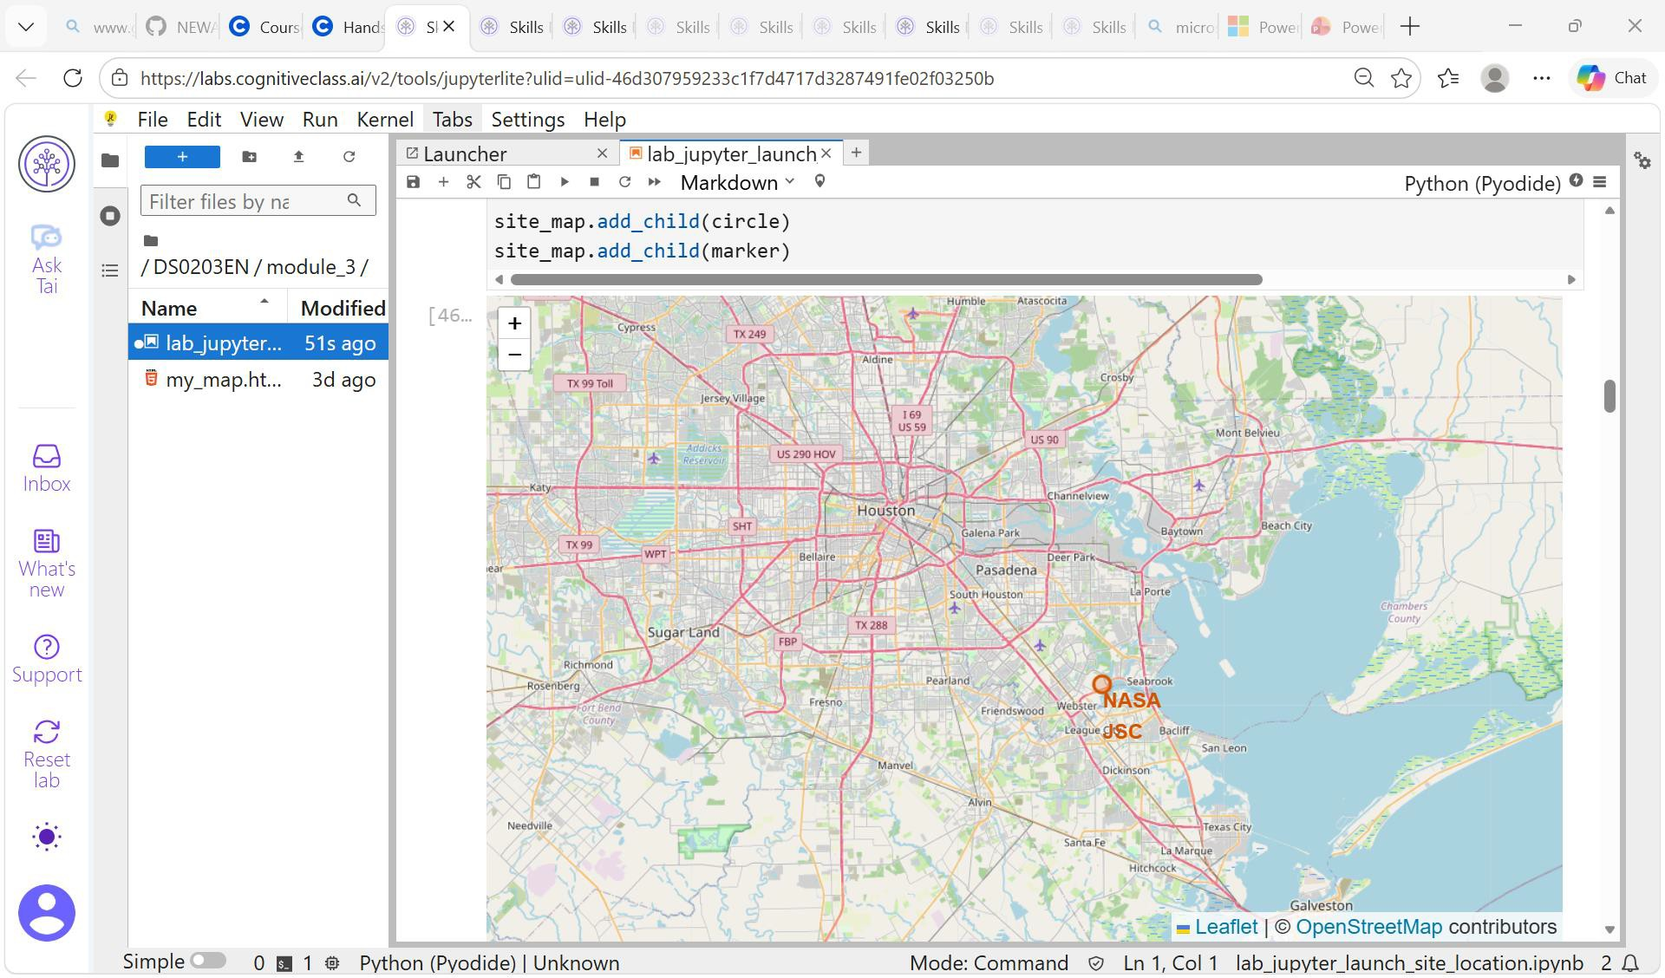
Create a folium map object with an initial center location to be NASA Johnson Space Center at Houston, Texas.

Slide 53
Generated map with marked launch sites

Slide 54
# Task 2: Mark the success/failed launches for each site on the map
VAFB SLCE-4E, CCAFS SLC-40

Slide 55
enhancd map by adding the launch outcomes for each site, and see which sites have high success rates.
 | Launch Site | Lat | Long | class
46 | KSC LC-39A | 28.573255 | -80.646895 | 1
47 | KSC LC-39A | 28.573255 | -80.646895 | 1
48 | KSC LC-39A | 28.573255 | -80.646895 | 1
49 | CCAFS SLC-40 | 28.563197 | -80.576820 | 1
50 | CCAFS SLC-40 | 28.563197 | -80.576820 | 1
51 | CCAFS SLC-40 | 28.563197 | -80.576820 | 0
52 | CCAFS SLC-40 | 28.563197 | -80.576820 | 0
53 | CCAFS SLC-40 | 28.563197 | -80.576820 | 0
54 | CCAFS SLC-40 | 28.563197 | -80.576820 | 1
55 | CCAFS SLC-40 | 28.563197 | -80.576820 | 0

Slide 56
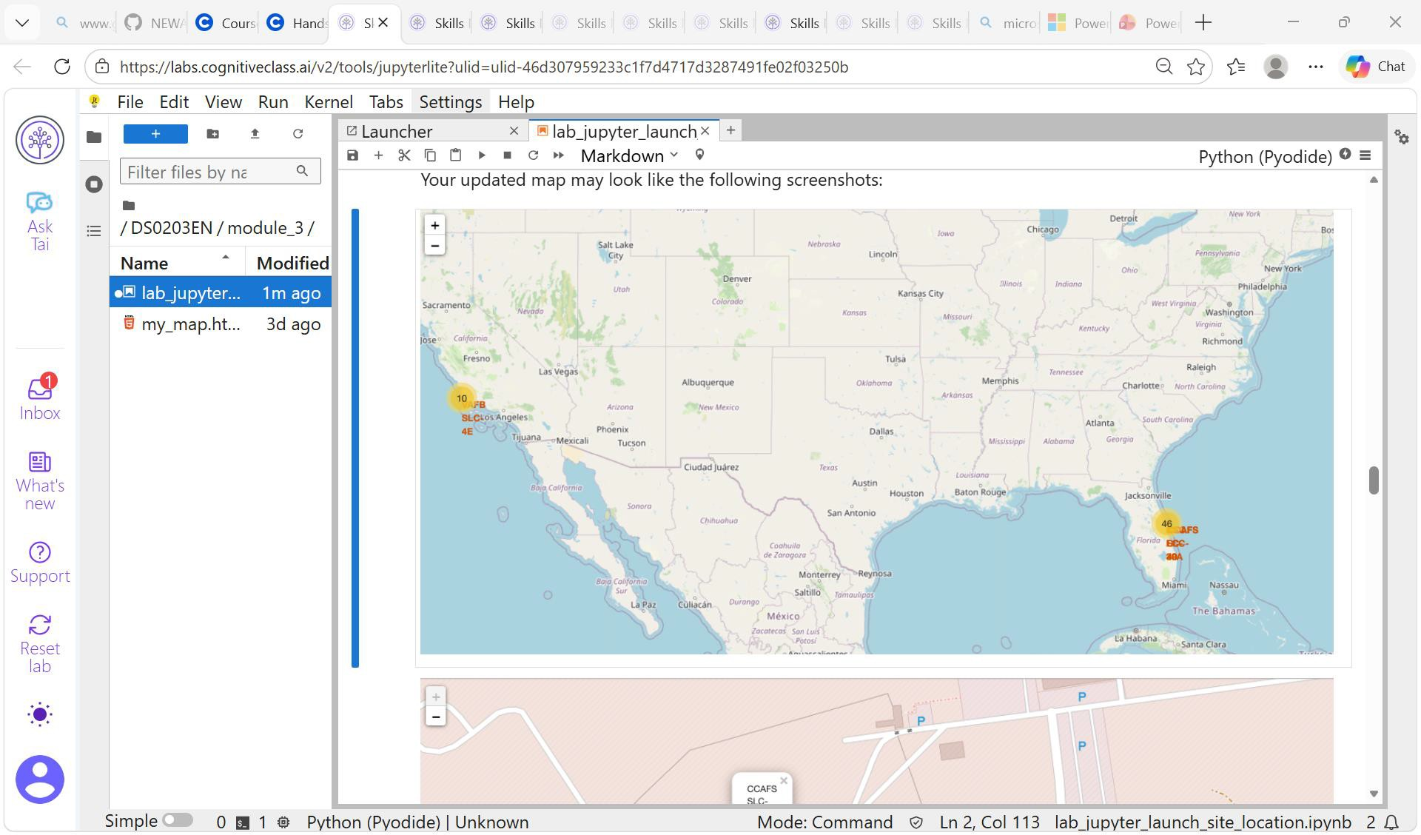
Simplify a map containing many markers having the same coordinate

Slide 57
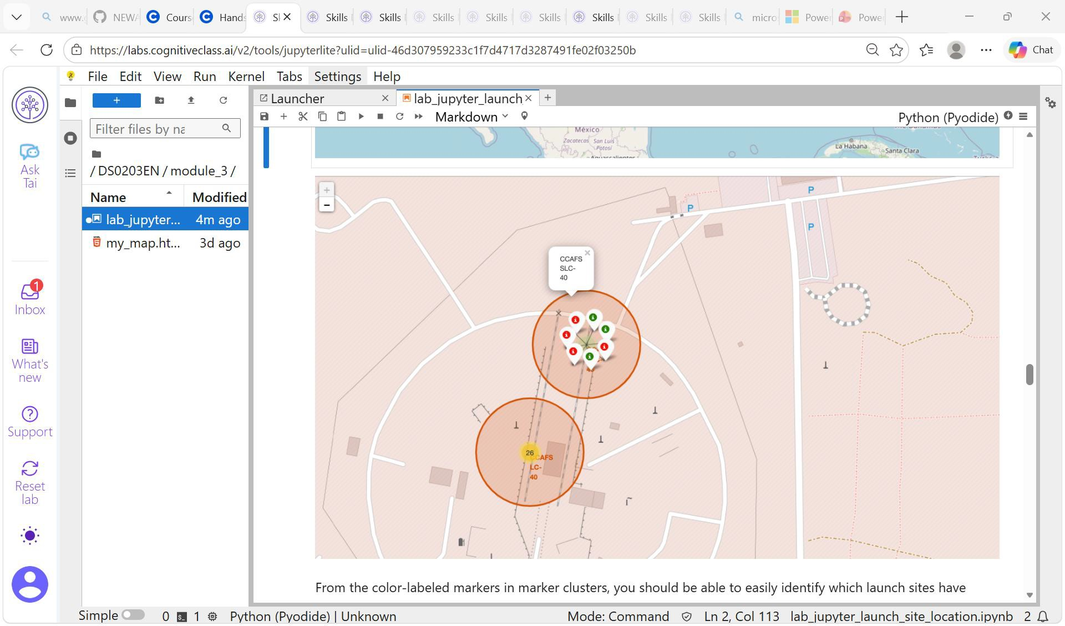
Easily Identifiable Launch sites with relatively high success rates

Slide 58
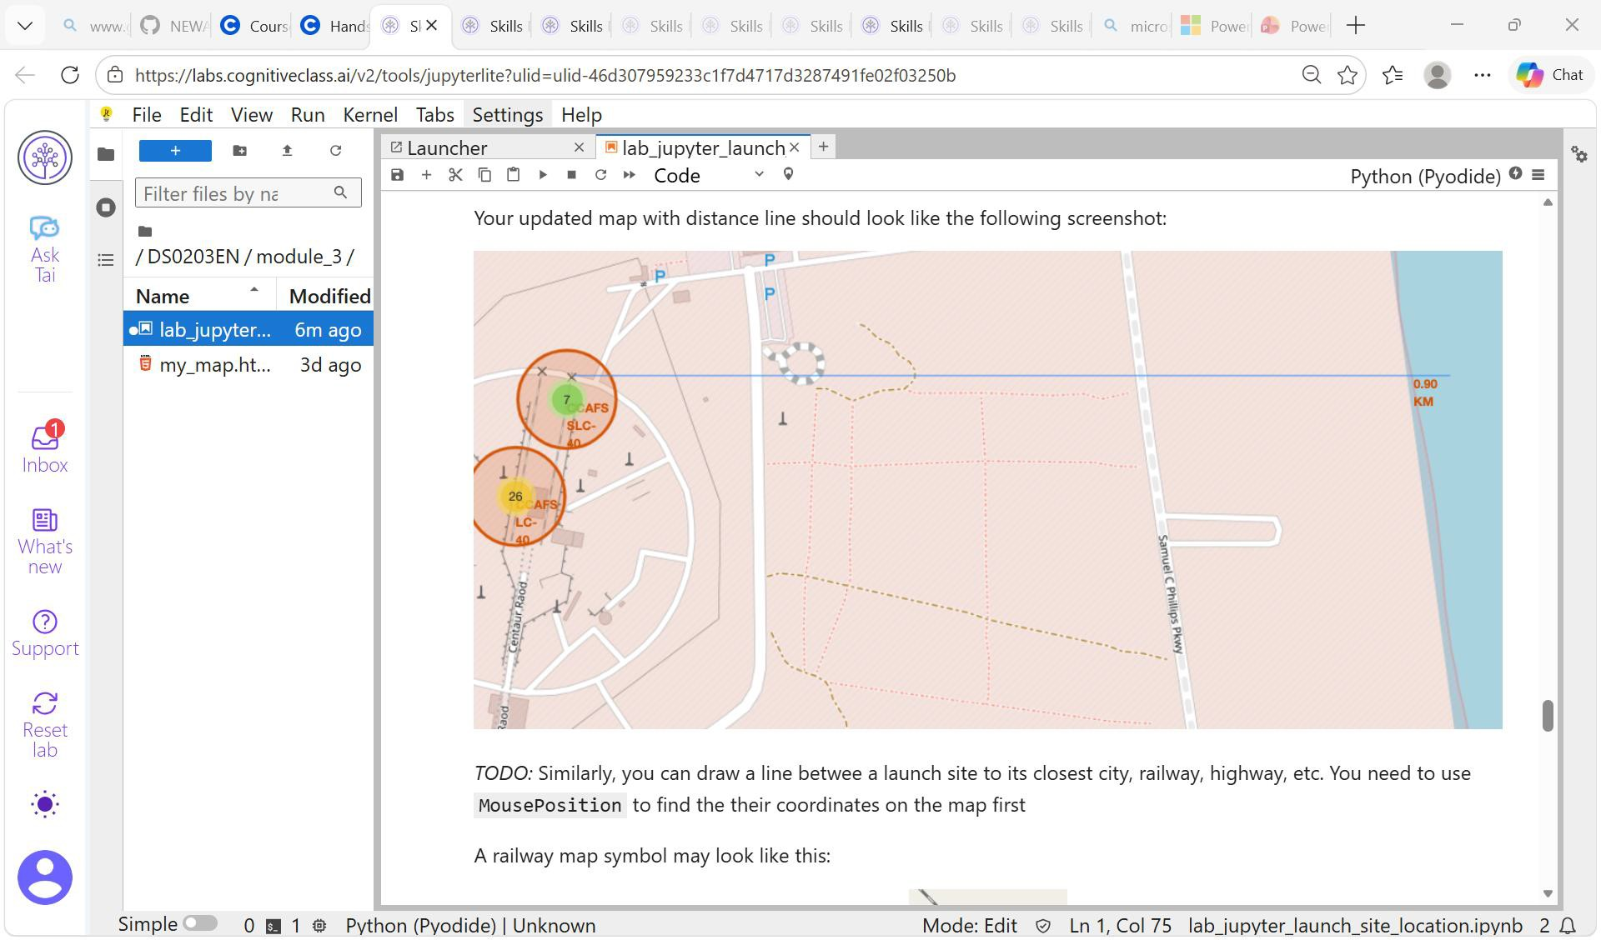
TASK 3: Calculate the distances between a launch site to its proximities

Slide 59
# Create a marker with distance to a closest city, railway, highway, etc.
# 1. Define locations (Latitude, Longitude)locations = { "Point A": (40.7128, -74.0060), # New York "Point B": (34.0522, -118.2437), # Los Angeles "Point C": (41.8781, -87.6298) # Chicago}# Initialize the Folium Mapm = folium.Map(location=[39.8283, - 98.5795], zoom_start=4)

Slide 60
# Geocoding: Get coordinates from an address
location = coordinates.geocode("Houston Texas, Clear Lake
Area")print(f"Coordinates : (l29.559684888503615,-95.0830971930759)")# Reverse
Geocoding: Get address from coordinatesreverse_location =
geolocator.reverse(f"Coordinates : -
95.0830971930759,l29.559684888503615)")print(f"Reverse Address:
{reverse_location.address}")# Process each markercoords_list =
list(locations.values())names_list = list(locations.keys())for i, (name, point) in
enumerate(locations.items()):# Calculate distance to the closest proximity point
min_dist = float('inf') closest_name = ""
for j, other_point in
enumerate(coords_list):
if i == j: continue # Skip comparing the point to itself
# Calculate geodesic distance in kilometers
if dist< min_dist: min_dist = dist
closest_name = names_list[j]# Create Marker with distance info in the popup
popup_text = f"{name}<br>Closest to: {closest_name}<br>Distance: {min_dist:.2f}
km" folium.Marker( location=point, popup=folium.Popup(popup_text,
max_width=300), tooltip=f"Click for distance info" ).add_to(m)# Save or displaym.save("proximity_map.html")

Slide 62
Plotly dashboard results Slide
Hands on Lab build in an Interactive Dashboard with Plotly Dash

Slide 63
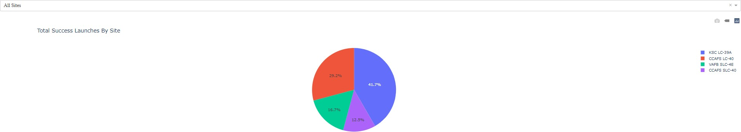
Total Launches by Site

Slide 64
Total Success Launches by Site

Slide 65
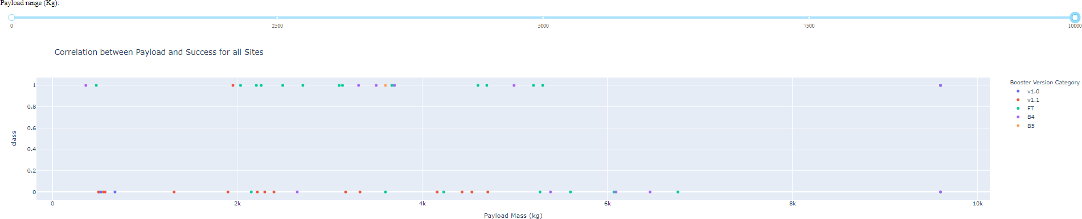
Correlation between Payload and Success for all sites

Slide 66
Predictive analysis (classification) results slides
Predictive analysis (classification) results slides

Slide 67
Load the dataframe
Load the data data.head()
FlightNu
_{Date} BoosterV Payload _{Orbit} LaunchSi Outcom
e
Flights
GridFins
Reused
_{Legs} LandingP
_{Block} ReusedC
Serial
Longitud
e
Latitude
Class
mber ersion Mass te
ad
ount
0
1
2010-06-
04
_{Falcon 9} 6104.959
LEO
CCAFS SLC 40
None None
1
False
False
False
NaN
1.0
0 B0003 80.57736
6
⁻ 28.56185
0
412
7
1
2
2012-05-
22
_{Falcon 9} 525.0000
LEO
CCAFS SLC 40
None None
1
False
False
False
NaN
1.0
0 B0005 80.57736
6
⁻ 28.56185
0
00
7
2
3
2013-03-
01
_{Falcon 9} 677.0000
ISS
CCAFS SLC 40
None None
1 | False | False | False | NaN | 1.0 | 0 | B0007 | 80.57736
 |  |  |  |  |  |  |  | 6
1 | False | False | False | NaN | 1.0 | 0 | B1003 | - 120.6108
 |  |  |  |  |  |  |  | 29
1 | False | False | False | NaN | 1.0 | 0 | B1004 | - 80.57736
 |  |  |  |  |  |  |  | 6
⁻ 28.56185
7
0
00
3
4
2013-09-
29
_{Falcon 9} 500.0000
PO
VAFB SLC 4E
False Ocean
34.63209
3
0
00
4
5
2013-12-
03
_{Falcon 9} 3170.000
GTO
CCAFS SLC 40
None None
28.56185
7
0
000

Slide 68
x.head(100)
90 rows × 83 columns
Payload Mass by Flight Number
PayloadMass
0
2000
4000 6000 8000 10000 12000
90 89 88 87 86 5 4 3 2 1
14000
16000
18000

Slide 69
Conclusion
In general, the launch success rate since 2013 kept increasing till 2020. unique launch sites in the space
mission include CCAFS SLC -40, KSL LC39, VAFB SLC-4E, CCAFS LC-40. It is worth note taking there were 55 successful and 10 failure mission outcomes respectively.
From Payload Mass Vs. Launch Site scatter point chart one will find for the VAFB-SLC launchsite there are no rockets launched for heavypaymass (mass (greater than 10000).
In general, the launch success rate since 2013 kept increasing till 2020. unique launch sites in the space
mission include CCAFS SLC -40, KSL LC39, VAFB SLC-4E, CCAFS LC-40. It is worth note taking there were
55 successful and 10 failure mission outcomes respectively.
With heavy payloads the successful landing or positive landing rate are more for Polar, LEO and ISS.
However, for GTO, it's difficult to distinguish between successful and unsuccessful landings as both
outcomes are present.
It was observed that in the LEO orbit, success seems to be related to the number of flights. Conversely, in
the GTO orbit, there appears to be no relationship between flight number and success.
There were no rockets launched for heavypayloadmass (greater than 1000) for VAFB-SLC. Success seems
to be related to the number of flights on LEO Orbit. However, there is no relationship between flight
number and success. It is recommended further investigations consider more variables to assess and
determine if whether the first stage will land successfully after training a machine learning model and use
public information to predict if SpaceX will reuse the first stage.

